Slide 1

Project Showcase PCPartVisualizer
BS-CS Batch 22
SDA Presentation
Ibrahim Awais 22i-0878
Muhammad Taha 22i-0983
Muneeb Ul Haq 22i-1321

Slide 2
Table of contents
01
02
03
04
Scope
Requirements
Intro, Features, and Feasibility
Functional and Non-Functional Requirements
Use Cases
Diagrams
Covers all aspects
Component, Deployment, and Package Diagrams

Slide 3
01
Scope

Slide 4
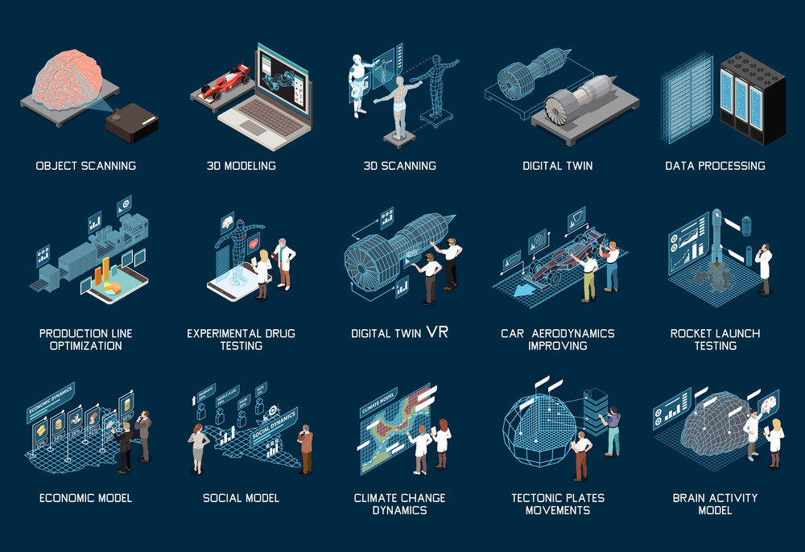

Slide 5
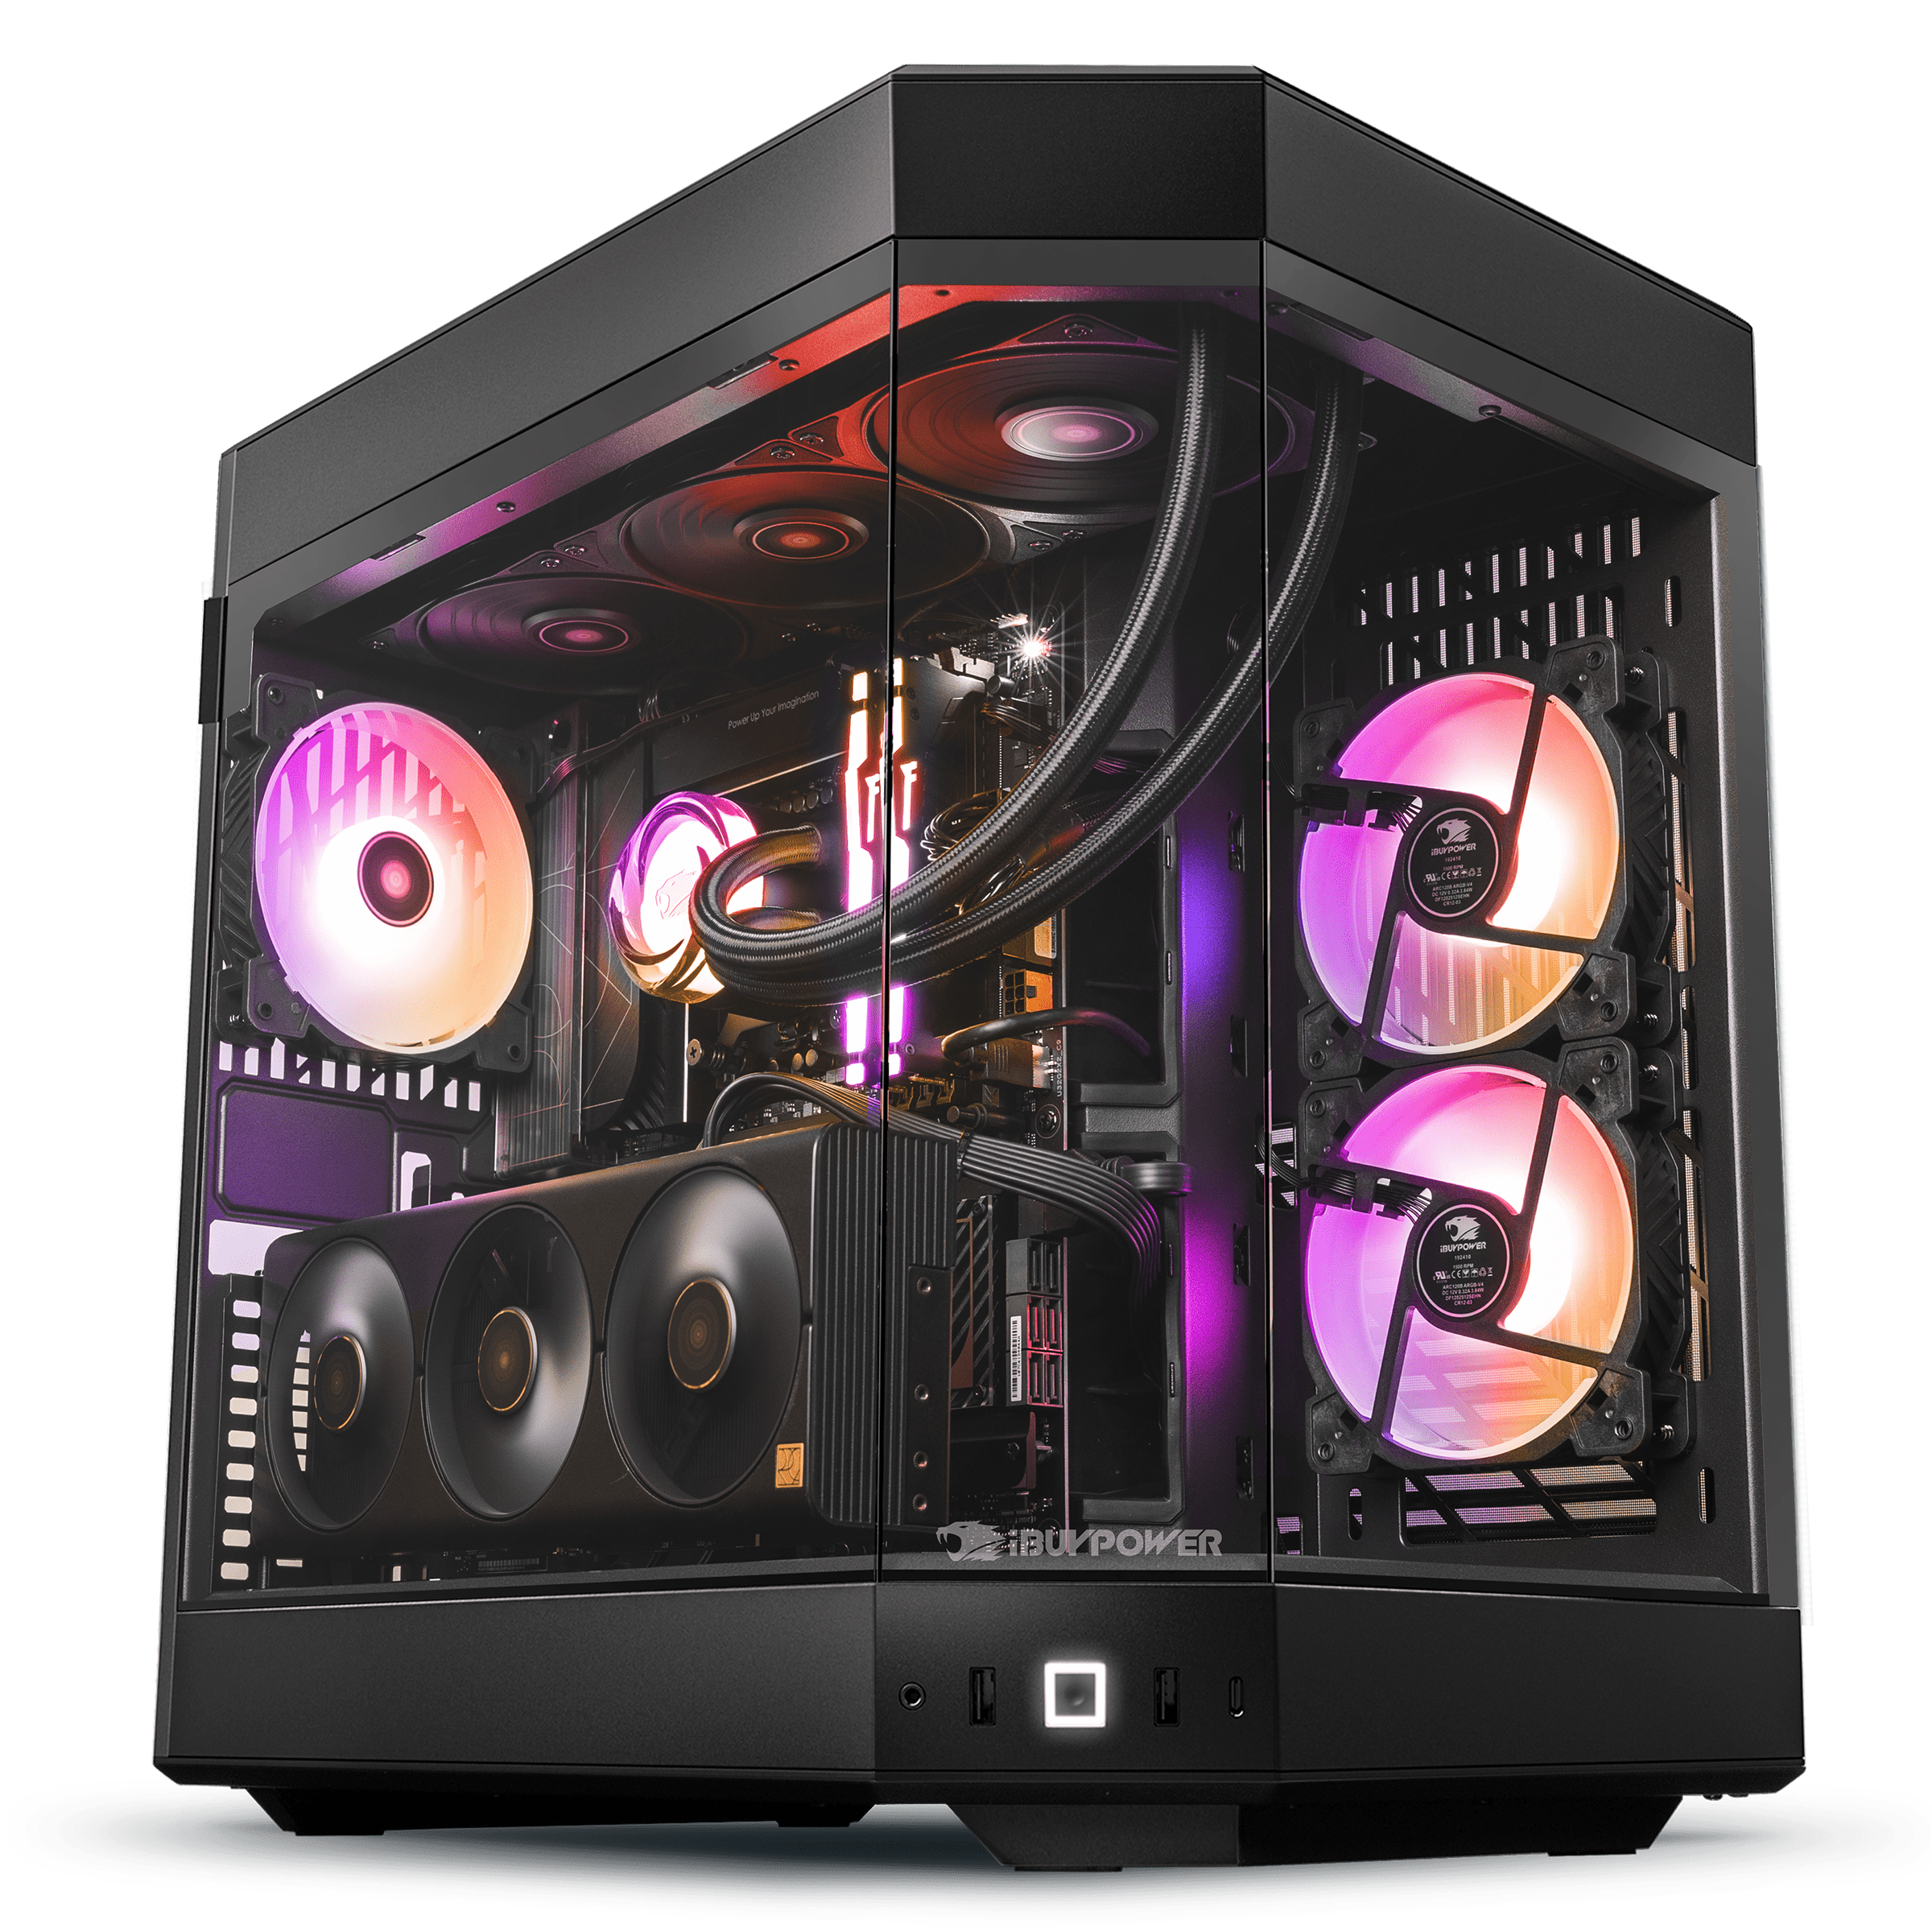
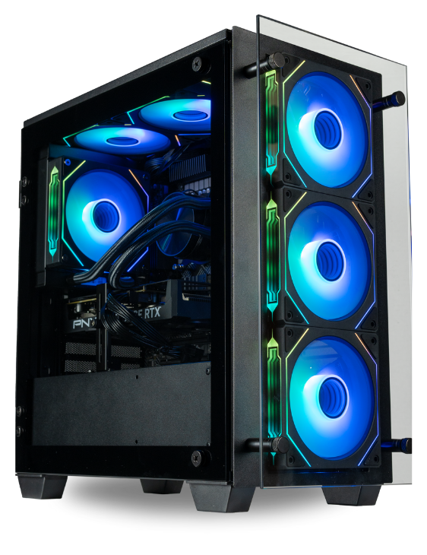

Slide 6
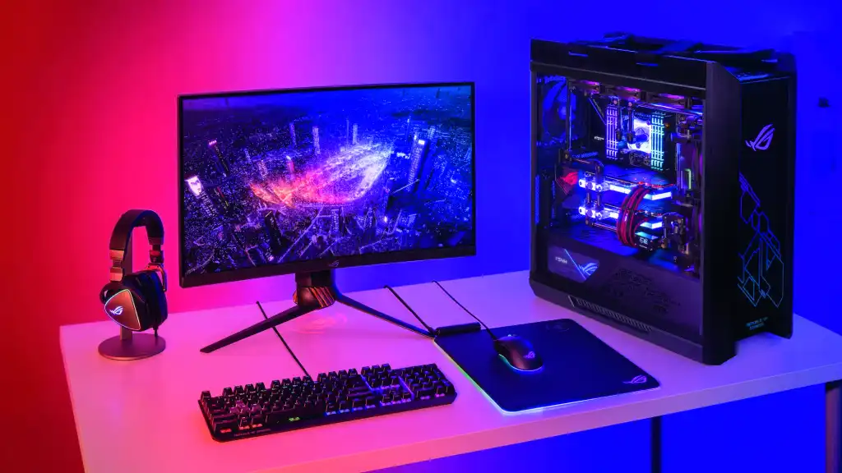

Slide 7
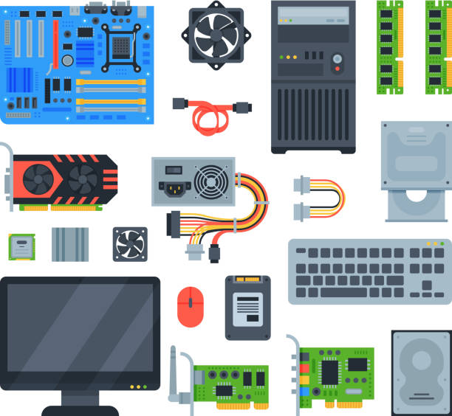

Slide 8


Slide 9
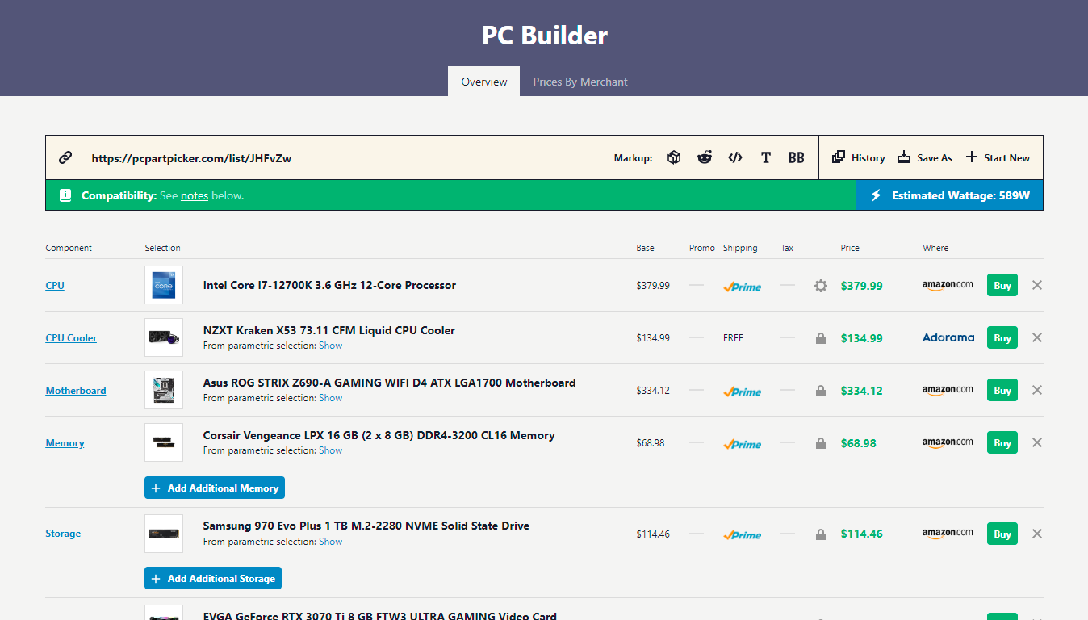

Slide 10
Only images

Slide 11
Objective
To enhance the PC Building experience with visualization

Slide 12
PCPartVisualizer
3D
Compatible
Visualization of Parts in 3D
Uses the PCPartPicker framework
Friendly Interface
Built for
Everyone
Visualization of Parts in 3D
PC Enthusiasts, Gamers, and Beginners

Slide 13
02
Requirements

Slide 14
Functional Requirements
Select PC components.
View 3D representation of builds.
Validate component compatibility.
Save and share build configurations.
Fetch part specifications from the database.

Slide 15
Non-Functional Requirements
Fast and responsive user interface.
High rendering performance for 3D models.
Secure storage and retrieval of user data.
Scalable backend architecture for multiple concurrent users.
Adherence to software licenses and legal requirements.

Slide 16
03
Use Cases

Slide 17
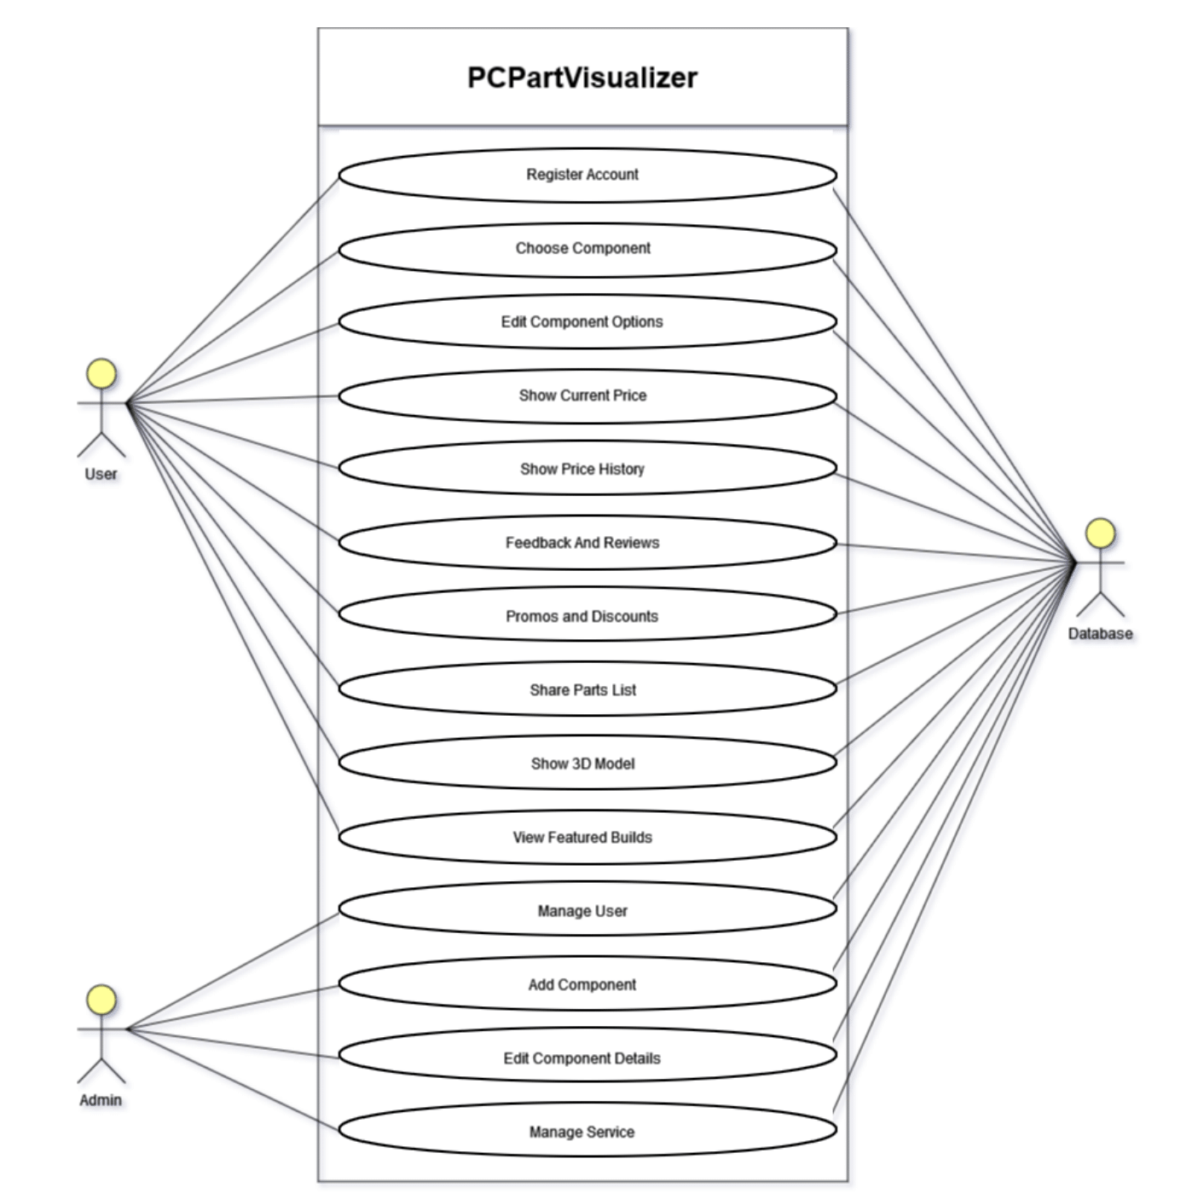

Slide 18

Diagrams

Slide 19
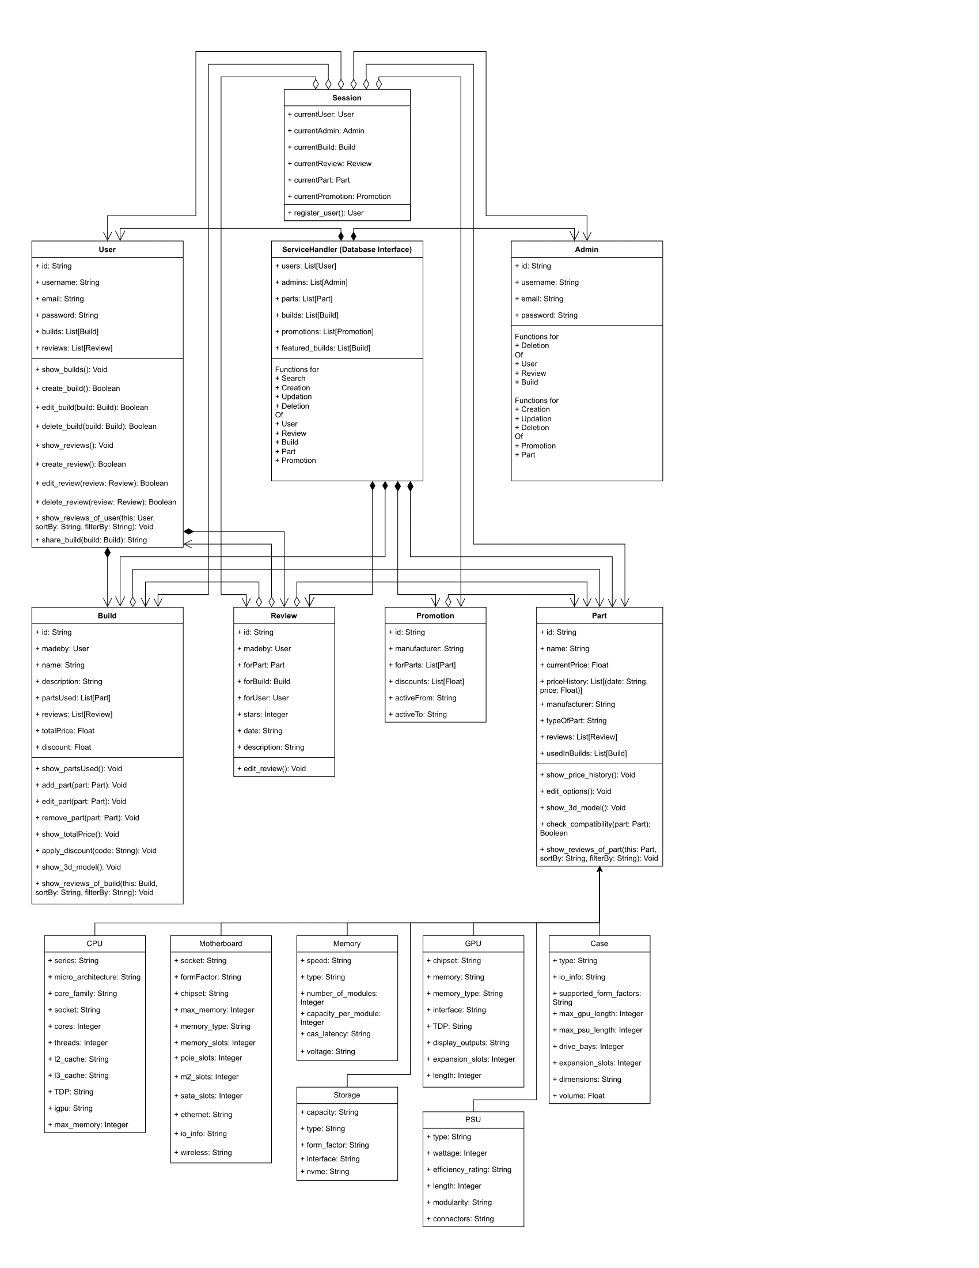
Class Diagram

Slide 20
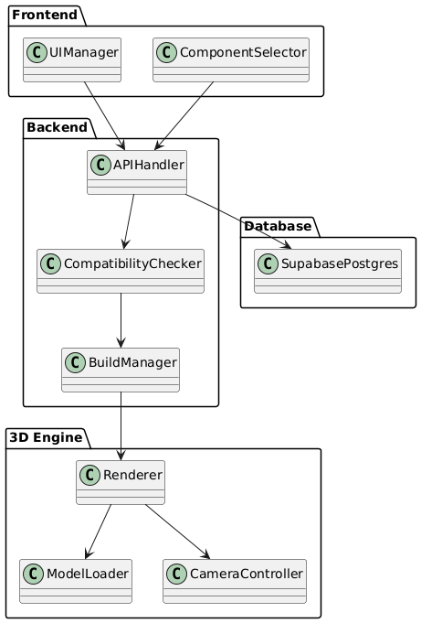
Package Diagram

Slide 21
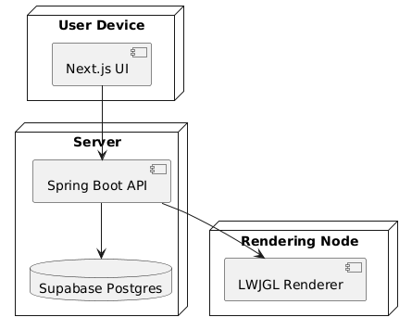
Deployment Diagram

Slide 22
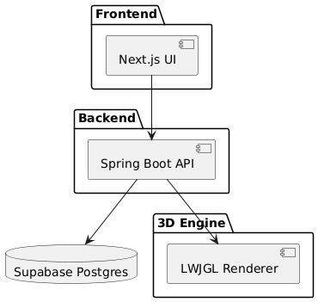
Component Diagram

Slide 23
Interface Screenshots

Slide 24
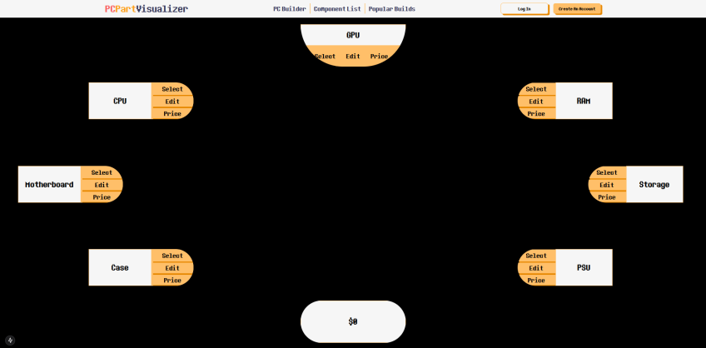
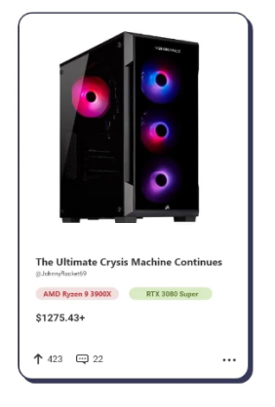
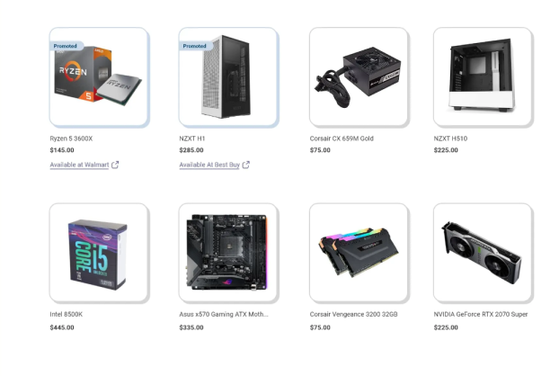

Slide 25
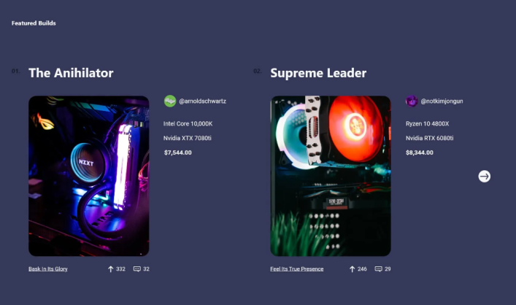

Slide 27
Conclusion
Do you have any questions?
Amir.rehman@nu.edu.pk
+92 111 241 241
csjournal.readthedocs.io
A presentation by:
Ibrahim Awais 22i-0878
Muhammad Taha 22i-0983 Muneeb Ul Haq 22i-1321

